Slide 1
Medicinal chemistry of Sedative-hypnotics

Slide 2
Physiology of Sleep
One-third of our life is spent in sleep, which has a major influence on
an individual's physical, social, and psychological well-being
both wakefulness and sleep: active processes, two ends of a continuum.
  reduced cortical responses to external stimuli
  Distinct from complete states of unconsciousness (e.g., coma), unresponsive to all external stimuli

Slide 3
sleep/wake cycles are regulated to a large degree by endogenous
circadian rhythms & homeostatic mechanisms
  factors within the reticular formation: a relay center that transmits
  afferent input to the cortex
  governed by a myriad of neuronal pathways
  ascending reticular activating system (ARAS)
    projections to and from various nuclei within the brainstem can modulate ARAS activity to facilitate wakefulness and sleep

Slide 4
Include
  serotonergic neurons of the raphe nucleus within the reticular formation itself;
  cholinergic neurons of the pedunculopontine tegmentum and
  noradrenergic neurons of the locus coeruleus, within the pons;
  dopaminergic neurons of the substantia nigra and ventral tegmental areas of the midbrain
regulated in a highly orchestrated manner primarily by the excitatory neurotransmitter glutamate and the inhibitory neurotransmitter GABA to regulate their respective activities

Slide 5
stimulation of the tuberomammillary nucleus (TMN) within the posterior hypothalamus facilitates wakefulness and arousal, and these cells are predominantly active only during wakeful periods
dependent on histaminergic neurons that densely project into the cortex & other wake-promoting structures within the brainstem
lesioning of histaminergic neurons within the TMN promotes sleep
the release of histamine from these neurons is increased upon and during wakefulness and is under the control of glutaminergic-stimulatory and GABAergic-inhibitory circuits
mediated primarily by histamine H1 receptors

Slide 6
anterior-hypothalamus, specifically the suprachiasmatic nucleus (SCN) (induction of sleep, its lesion: wakefulness) endogenous master clock
SCN receives visual input from the retina via the retinohypothalamic tract, and this key connection serves to synchronize circadian rhythms to daylight
The firing rate of SCN neurons is strongly correlated with day/night cycles, which serve to establish an approximate 24-hour circadian rhythm
Largely under the control of glutaminergic and GABAergic neurons, which originate in the preoptic nucleus
works in concert with the pineal gland to regulate circadian rhythms
inhibitory GABAergic outflow from SCN neurons to the pineal gland is enhanced during the daylight hours and declines proportionally to decreases in daylight

Slide 7
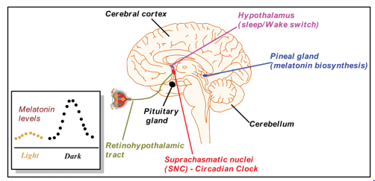
Light sensitive neurons(SCN)
GABA-ergic, GABA during daylight
Paraventricular neurons (PVN)
NE-ergic, NE during daylight
Pineal gland(α₁,β₁)
As result, activation decreases daytime, 10-fold) synthesis and release of melatonin
GABa-ergic
GABA/Glu-ergic
Preoptic nucleus
SCN
Enhanced during daylight

Slide 8
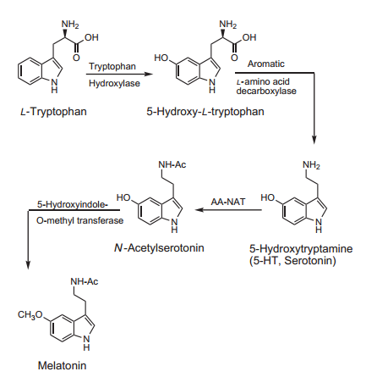
arylalkylamine N-acetyltransferase (AA-NAT)
5-hydroxyindole-O-methyltransferase (HIOMT)
β1-receptor–mediated increases in intracellular cyclic AMP stimulate AA-NAT expression and also increase protein kinase A (PKA)–mediated phosphorylation of AA-NAT, which stabilizes and activates the enzyme
increases in light lead to decreases in AA-NAT activity
Activity of AA-NAT can also be effectively abolished by lesions of the SCN
Biosynthesis of melatonin

Slide 9
melatonin has profound effects in the SCN, where it agonizes MT1R to mediate the acute inhibition of SCN neurons, thereby promoting sleep
Additionally, agonism of MT2R in the SCN is associated with the phase-shifting effects on circadian rhythms

Slide 10
three physiological states exist:
  Alert wakefulness(of high-frequency (15 to 25 Hz) alpha-wave events )
  Nonrapid eye movement (NREM) sleep(“quiet sleep”, four stages)
    low metabolic rate and low neuronal activity,
    heart rate and blood pressure,
    increase in parasympathetic nervous system activity
    decrease in sympathetic activity
    pupillary constriction, which diminishes the amount of light that is allowed to enter the retina

Slide 11
stage 1: 5 to 15 minutes
  period of transitioning from wakefulness to sleep
  progresses to the light or drowsy sleep
  slower theta waves with lower frequency (4 to 10 Hz)
stage 2 (light sleep): lasts 15 to 20 minutes cteristic sleep
spindles, which are short bursts of higher frequency (12
  theta waves continue but are periodically interrupted by charato 15 Hz) EEG events
  skeletal muscle activity is decreased in this stage

Slide 12
Stages 3 and 4 : slow-wave sleep, deep sleep
  appearance of higher amplitude,
  slower frequency (0.5 to 4 Hz) delta waves
  more often in stage 4
  If awakened in this stage of sleep, an individual will likely be confused and disoriented

Slide 13
REM sleep (“active sleep”, single stage)
  characterized by increases in eye movement, respiration
  rate, and brain activity
  high-voltage firing spikes, which seem to originate in the pons, lateral geniculate nucleus, and occipital cortex, and these spikes are correlated with bursts of rapid eye movements associated with this stage of sleep
  first REM stage occurring after 75 to 90 minutes of nonREM sleep

Slide 14
55% to 60% of sleep time is)
spent in stages 1 and 2 (light sleep)
20% in stages 3 and 4 (deep sleep)
20% to 25% in stage 5 (REM sleep

Slide 15
PHARMACOLOGIC TARGETS OF SEDATIVEHYPNOTIC AGENTS
nearly every neurotransmitter system in the mammalian brain, including the
  adenosinergic, serotonergic, dopaminergic, adrenergic, histaminergic, and cholinergic systems,
  have at one time or another been associated with induction of sleep or wakefulness

Slide 16
the development of sedative-hypnotic agents has primarily focused on
  1) agents that cause CNS depression via agonism of GABAA
  receptors, and
  2) agents that modulate hypothalamic histamine or melatonin circadian systems that regulate sleep and arousal.

Slide 17
GABA A Receptors
GABA is major inhibitory neurotransmitter in CNS
  is critical in balancing neuronal excitation
  widely distributed throughout the CNS
  up to 1,000-fold (high mmol/L to low mmol/L) greater than that of monoaminergic NTs in various CNS nuclei
Two distinct classes of membrane-bound receptors
  ionotropic GABAA receptors (ligand-gated ion channels)
  metabotropic GABAB receptors

Slide 18
The activation of GABA A receptors on excitable neurons
  membrane hyperpolarization
    facilitates an increase in the firing threshold potential and
    consequently reduces the likelihood of generating an action potential
  agonism of GABA receptors leads to neuronal inhibition and CNS depression
  important targets for treatment of a variety of CNS disorders in which CNS depression
  provides a therapeutic benefit, including
  anxiety, anesthesia, convulsions and seizures and sleep disorders

Slide 19
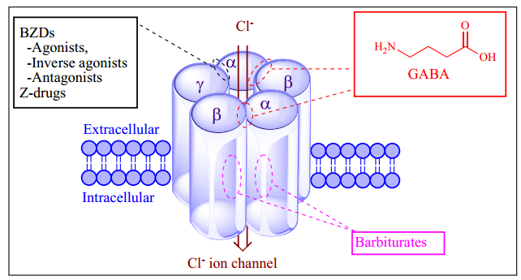
GABAA receptor model depicting different molecular subunits (α, β, γ) plus the BZD, Z-drugs and GABA binding sites. BZDs and Z-drugs non-selectively bind to the α1-3 subunits of GABAA

Slide 20
Medicinal chemistry of BARBITURATES

Slide 21
were used extensively as sedative–hypnotic drugs
Barbiturates act throughout the CNS
they exert most of their characteristic CNS effects mainly by binding
to an allosteric recognition site on GABAA receptors that positively modulates the effect of the GABAA receptor—GABA binding
GABA mimetic effect
5,5-disubstituted barbituric acids reveals their acidic character

Slide 22
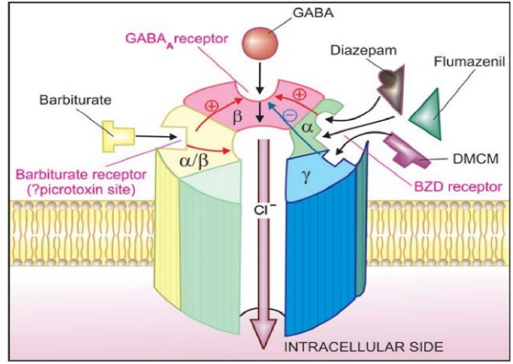

Slide 23
In 1864 von Baeyer synthesized the first barbiturate, barbituric acid
The first hypnotic barbiturate, diethylbarbituric acid, was synthesized by Fischer and Mering in 1903
  but all had too slow onset and too long duration of action
In 1932 Weese and Schapff synthesized the first rapid onset, short duration barbiturate, the methylated oxybarbiturate hexobarbital
  caused undesirable excitatory side effects
Thiopental was first administered by Waters (Wisconsin) and Lundy (Mayo Clinic) in 1934.
Thiopental proved to be fast and brief acting and devoid of excitatory side effects

Slide 24
In 1950 Brodie et al demonstrated that barbiturate hypnotic-sedative activity was terminated not by metabolism, but by redistribution from central neural sites of action to other body tissues.

Slide 25
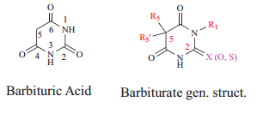
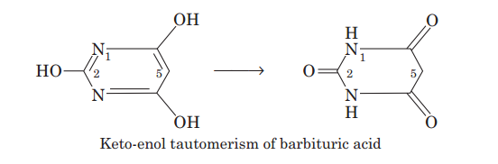
Barbiturates
chemical derivatives of barbituric acid or 2,4,6-trioxohexahydropyrimidine
  devoid of hypnotic and sedative activities
  Keto-enol tautomerism of barbituric acid and barbiturates allows formation of water soluble salts with a strong base.
(pKa =4)
largely in the anionic form at physiological pH

Slide 26
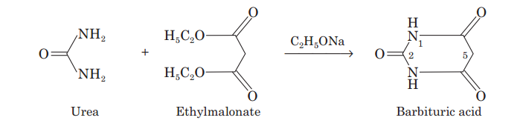
may be described as a “cyclic ureide of malonic acid”.
Barbituric acid can be made by condensing urea with ethyl malonate in presence of sodium ethoxide.
Clinically important hypnotic-sedative barbiturates have substitutions at sites 1, 2 and, especially, 5 of barbituric acid

Slide 27
promoting the inhibitory actions of GABA
possess sedative-hypnotic, anxiolytic, anesthetic, anticonvulsant effects, and act via allosteric modulation of GABAA
infrequently used as sedative-hypnotics due to their
  toxicity (narrow therapeutic index), greater CNS depression, and abuse liabilities,
  induce CYP450 enzymes as well as some phase II enzymes(concern in polypharmacy-DDIs- sub-optimal pharmacotherapy)

Slide 28
continue to find clinical utility in other disorders (e.g., phenobarbital’s use in hyperbilirubinemia and the relief of intracranial pressure in traumatic brain injury
Barbituric acid itself has no CNS depressant effects but alkyl and aromatic R5/R5’ substituents impart sedative hypnotic as well as anti-epileptic activities in the derivatives
  Oxybarbiturates(C2 carbonyl (C=O))
  thiobarbiturates(C2 carbonyl (C=S)(more lipophilic, rapid onset, reduces drug terminal half-life(from >30 to <15 hours)

Slide 29
Unsubstituted and electron withdrawing group (EWG) C5 di-substituted barbiturates are
  weak acids (pka 4 -8), exhibit lower H₂O solubility, and are absorbed slowly orally
form sodium (Na) salts in high (pH >12 pH) solutions (e.g., sodium hydroxide or NaOH solutions).
Lowering the pH of these alkaline drug solutions can lead to incompatibility issues and the formation of insoluble barbiturate precipitates (cloudy aqueous solutions).
Also,alkalizing urinary pH with sodium bicarbonate (Na₂CO₃) often promotes barbiturate excretion in urine.

Slide 30
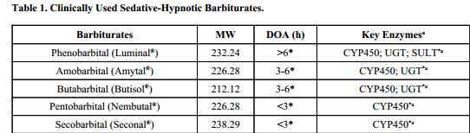
Lower dose (anxiolytic)
High dose(hypnotic)
  directly activate GABAA in the absence of GABA
  cause cardiovascular and respiratory depression and may be fatal
Very high barbiturate dose: block the Cl ion conductance thereby limiting the extent of drug response
Barbiturates are also grouped according to their duration of action (DOA)

Slide 31
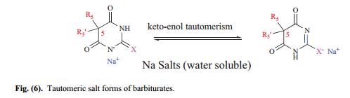
Individual Barbiturate Drugs
Clinical barbiturates are mostly sodium (Na) salts whose solution forms exist in keto-enol tautomeric equilibria
C₅ substituents (i.e., R_{5′} and R₅) introduce differences in potency and distribution pharmacokinetics and therefore the duration of action
their excretion rates can be altered by urine pH (higher or alkaline pH favors ionization and enhanced renal excretion)
C5 substitutions groups determine lipophilicity

Slide 32
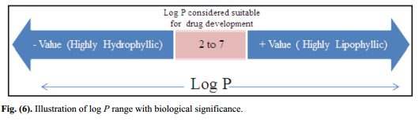
Lipophilicity and route of administration impact both DOA and drug onset of action
sedating barbiturates require log P values of 2 for optimal activity
Highly lipophilic
  higher log P values,
  longer chain C5 alkyl substituents) barbiturates exhibit rapid onset and short DOAs due to equilibration facilitated tissue redistribution from the brain to other fatty tissue.
  cross the placenta during pregnancy and distribute into breast milk
  long-lived ones, induce hepatic 1A2, 2C9, 2C19, 3A4 and UGT enzymes

Slide 33
Barbiturate tolerance due to increased barbiturate metabolism
prolonged use of barbiturates can desensitize and down-regulate GABAA leading to tolerance
Overall, drug-metabolizing enzyme (DME) induction and
inhibition are sources of pharmacokinetic or metabolism-based DDIs for barbiturates

Slide 34
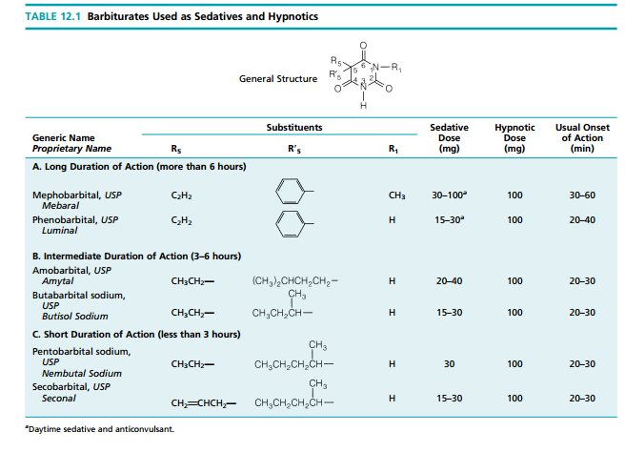

Slide 35
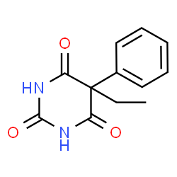
Long Acting Barbiturates (DOA> 6 h)
Phenobarbital (Luminal)(a positive allosteric modulator of GABAA receptor)
Substitution: N-methyl plus C-5 substituents (one ethyl- and one phenyl).
mainly clinically used as an anti-epileptic agent.
induces CYP and glucuronidating enzymes.
  cause of most pharmacokinetic DDIs associated with phenobarbital.
Exhibits relatively lower lipophilicity (log P 1.46) and plasma binding versus other barbiturates.
Is inactivated by CYP450 catalyzed para-aromatic hydroxylations or p-ArOH
and subsequent phase II metabolism via glucuronidation and sulfation reactions

Slide 36
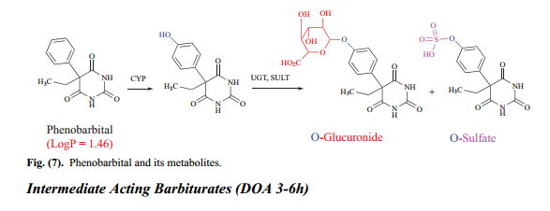

Slide 37
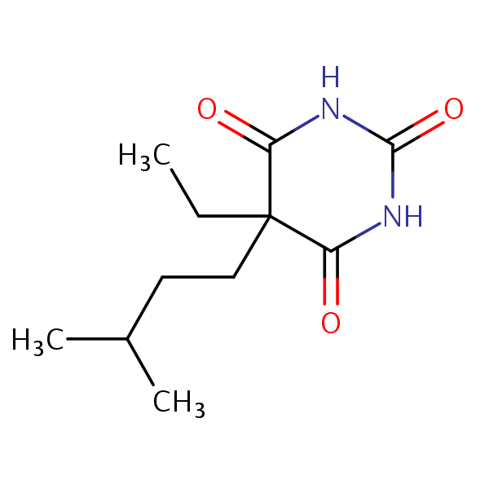
Amobarbital and Butabarbital
Primarily used as sedative hypnotics.
Substitutions: Butyl and Ethyl alky chains C5 substitutions are present.
Exhibit log P values of 1.6 - 2, and therefore are more lipophilic than phenobarbital.
Are metabolized via hydroxylation (red arrows) and subsequent conjugation into glucuronides and sulfates.

Slide 38
Amobarbital can undergo ω-1 or ω (or terminal carbon) oxidations, while Butabarbital is metabolized on its butyl chain.
Terminal alcohol intermediates can be oxidized to aldehydes and carboxylic acids before elimination.
Metabolism to glucuronide and sulfate conjugates makes these molecules hydrophilic, less lipid-soluble, thereby inactivates them and facilitates renal excretion.

Slide 39
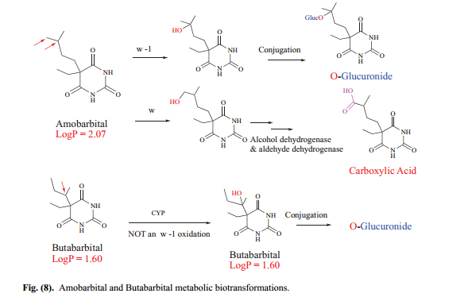


Slide 40
Short Acting Barbiturates (DOA< 3 h)
Pentobarbital and Secobarbital
Are sedative hypnotics used to induce anesthesia (quick onset and very short DOA).
Substitutions: C5 groups (ethyland allylor five carbon alkyls) are present.
Exhibit log P values of greater than 2 and are the most lipophilic barbiturates.
Their metabolic fates or profiles are similar to those of the intermediate acting agents, and are therefore inactivated in a similar fashion.

Slide 41
Rapid metabolism and tissue redistribution account for their short DOA.
Pentobarbital itself undergoes ω-1 oxidation (red arrow).
Secobarbital, on the other hand, can undergo either ω-1 oxidation on its butyl chain (blue arrow) or olefinic oxidation to a vicinal diol (OH groups on adjacent carbons)

Slide 42
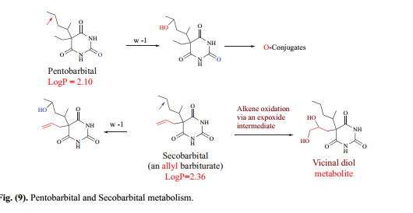

Slide 43
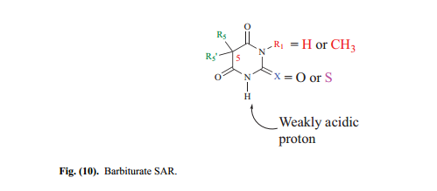
Barbiturate SAR

Slide 44
The unsubstituted barbituric acid lacks sedative-hypnotic activity
Alkyl R1 groups, when present, enhance lipophilicity
R5/R5’ or 5,5-di-substituents impart lipophilicity, activity and DOA.
R5/R5’ groups may be alkyl or aryl.
To be active, alkyl chain lengths need to be < 6 carbons
Electron donating groups (EDGs) increase barbiturate pKa (pKa >7) and vice versa for electron-withdrawing groups (EWGs).
Changes in pKa values influence water solubility
Replacement of “O” with “S” enhances lipophilicity and affords barbiturates with a quick onset of action

Slide 45
NON-BENZODIAZEPINES
This class of sedative-hypnotics comprises several older plus newer structurally and mechanistically dissimilar agents
Z-drugs, Zolpidem and Zaleplon act via α1-containing GABAA whereas Eszopiclone (the S-isomer or enantiomer of Zopiclone) targets α1, α2 and α3 -endowed GABAA receptors

Slide 46
Antiepileptic Drugs
use of potassium bromide was reported in the treatment of “hysterical epilepsy connected with the menstrual period” in young women and is considered the milestone for the modern antiepileptic drugs (AEDs)
the serendipitous discovery of phenobarbital (Luminal®) by Alfred Hauptmann in 1912 began the pharmacological era of AEDs
In 1936, phenytoin was clinically evaluated and successfully marketed in 1938 as a therapeutic agent to treat patients with frequent seizures and is still possibly the most widely used AED in
the US Later, trioxidone (1940s) and the less toxic ethosuximide (1958) were introduced for the treatment of petit mal seizures

Slide 47
Carbamazepine (1965) and valproic acid (1967) were introduced as anticonvulsants
In 1965, Henry Gastaut reported diazepam as the first effective benzodiazepine in treating status epilepticus and was followed by the introduction of clobazam, lorazepam, and midazolam as antiepileptic benzodiazepines
In 1975, the National Institute of Neurological Disorders and Stroke (NINDS) established the Anticonvulsant Drug Development Program in the US

Slide 48
screen many thousands of compounds to identify leads
conducted target-oriented design and led optimizations to discover the modern AEDs with unique mechanisms of action.
Modulation of voltage-gated cation channels (e.g., sodium and calcium channels), potentiation of GABA-ergic activity, inhibition of glutamatergic processes and modification of neurotransmitters are a few mechanisms by which these AEDs decrease neuronal excitation or increase neuronal inhibition to exhibit their pharmacological effects

Slide 49
Since then, the US FDA has approved several newer AEDs for use in epilepsy including perampanel (modulates AMPA mediated neurotransmission) and brivaracetam (binds to SV2A protein and sodium channels) and some others with novel mechanisms of action are in the immediate horizon to reach the marketplace, such as retigabine (opens potassium channels).
Today, there are several AEDs and structural/mechanistic relatives that appear in the frequently prescribed

Slide 50
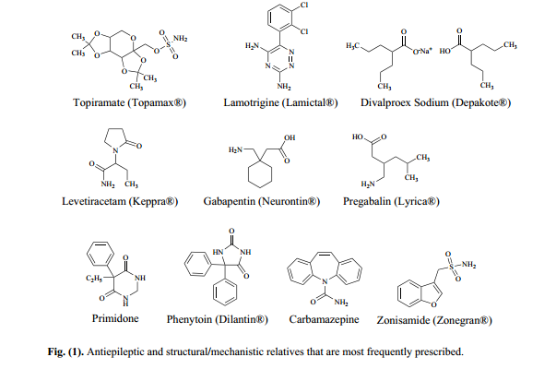

Slide 51
A seizure (Latin sacire meaning to take possession of) is caused by excessive neuronal excitation arising from disordered inhibition of a large population of cortical neurons.
Epilepsy is a neurological disorder arising from disturbed
electrical activities in the brain and defined by the International League Against Epilepsy (ILAE) as the occurrence of at least two unprovoked seizures separated by 24 hours.
An epileptic seizure is classified by the ILAE into three main types: partial, generalized, and unclassified seizures

Slide 52
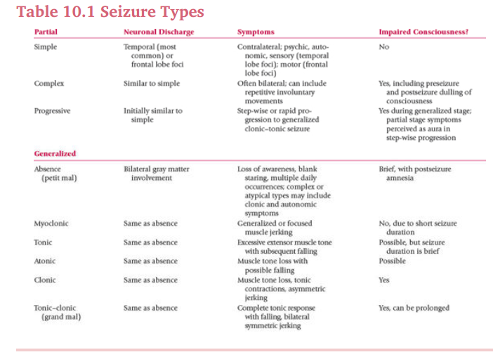

Slide 53
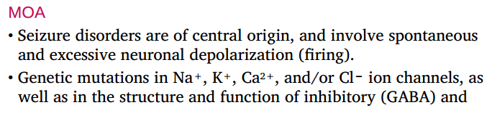
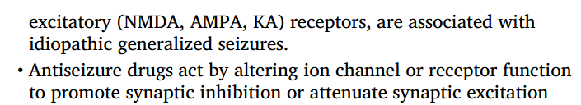
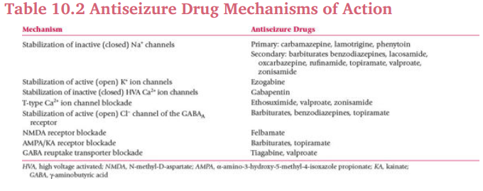

Slide 54
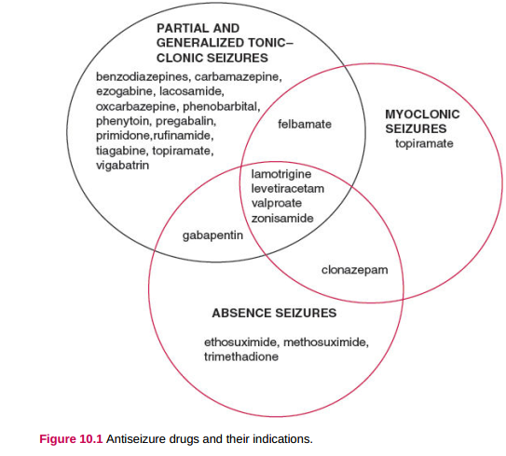

Slide 55
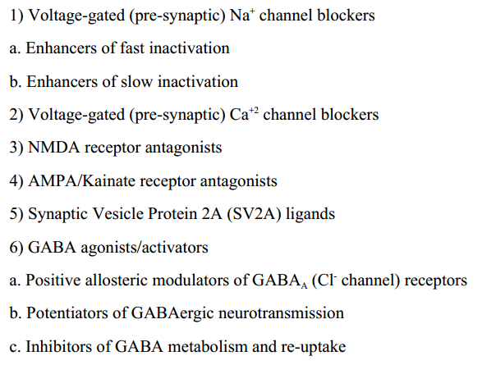
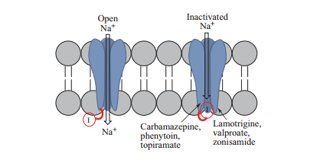
The major classes of antiepileptic drugs based on their mechanism of action include
Phenytoin
Lacosamide
gabapentin
felbamate
benzodiazepines and barbiturates

Slide 56
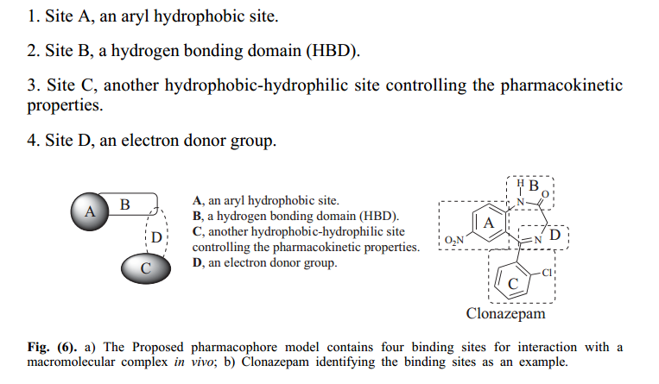
CHEMISTRY OF ANTIEPILEPTIC DRUGS
Pharmacophore for Antiepileptic Drugs
A suggested pharmacophore model of AEDs identifying clonazepam’s
pharmacophore sites
four functional sites are critical for optimal antiepileptic effects,

Slide 57
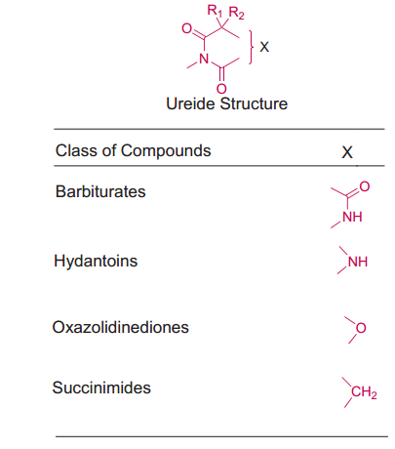

Chemical Classes of Antiepileptics Drugs
Ureides : any class of organic compounds derived from urea by replacing one or more of its hydrogen atoms by organic groups.
Hydantoins(glycolylurea) and barbiturates are imidazolidinedione and hexahydropyrimidinetrione structures, respectively

Slide 58
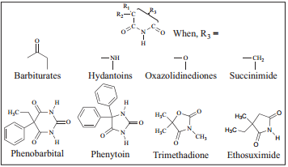
Barbiturates, hydantoins, oxazolidinediones, succinimides and amides (such as glutarimides) possess an imide, or acetyl ureas and cyclic (or acyclic) heteroatomic systems.

Slide 59
SAR
Activity against generalized seizures is optimal with at least one C5-phenyl substituent.
Among hydantoins, a 5,5-diphenyl substitution pattern (e.g., phenytoin) provides the highest activity.
Substitution at hydantoin N3 with small alkyl groups (e.g., methyl, ethyl) decreases potency, alters seizure specificity, and increases the potential for adverse eʃects, including sedation, severe rash, and blood dyscrasias (e.g., mephenytoin, ethotoin).
The impact of a similar substitution on barbiturates is less dramatic (e.g., mephobarbital)

Slide 60
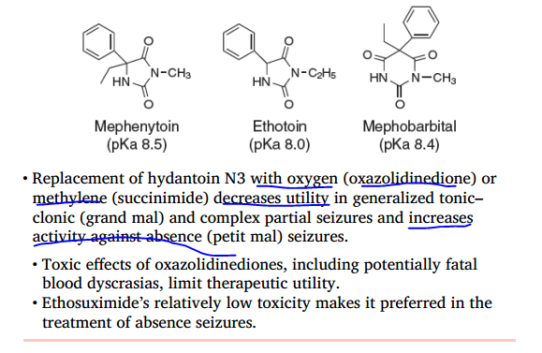

Slide 61
Iminostilbenes (dibenzazepines)
Chemical compound with two benzene rings fused to an azepine group.
Azepines: seven-membered heterocycles with one nitrogen atom.

